Slide 1


Group Members
Animesh
Palak
Raja
Harsh

Slide 2
Introduction
Standing still in the toy industry since 18th century, 256 years old
Reliance took over in 2019 to become the sole owner of Hamleys succeeding Hong Kong based company.
Hamleys mostly deals with all the products related to children like toys, stationaries and accessories.

Slide 3
Quick Fact!
1
Queen Victoria was a patron in mid 18th century.

Slide 4
Manufacture
Product Lifecycle Flow Diagram
Supplier
SCM
Retailer
Customer
Product Purchase
No
Yes
Feedback Form
Initial Feedback
Is customer has loyalty card?
Points added to the card
Yes
No
Promotional Offers

Slide 5
Case generated as per customer request
Support team
Follow up feedback
(online)
Escalated
Sales Team
No
Case Closure mail
Customer Feedback Analysis Flow
Yes
Management
Disagree
Case Closure mail
Agree
Manufacturer
Supplier
Yes
No
Case Closure mail
Yes/No
Support Team
System changes and Email to customer notifying changes
Case closure mail to customer

Slide 6
Data captured from Feedback Form (Alternate Shop)
Lead
Feedback Processing and Conversion
Contact
Opportunity
Account
Decision by Owner
Yes
No
Collaborated with Hamleys
Close as lost
Close as won

Slide 7
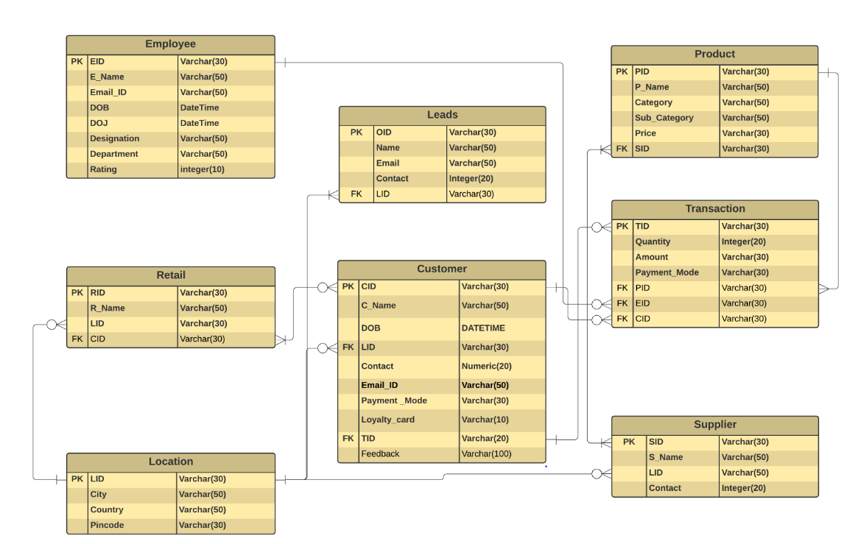
Database Design

Slide 8
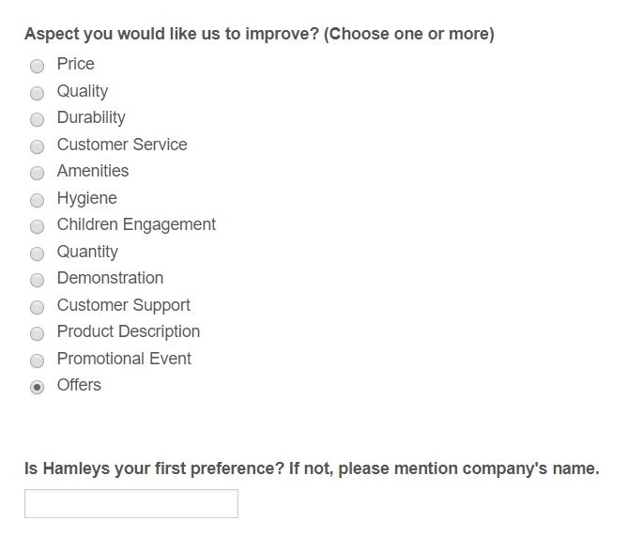
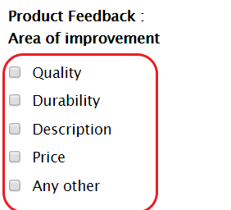
Data capture via Feedback Forms
Post Feedback Form
Initial Feedback Form

Slide 9




Balanced Scorecard
Increase Revenue
Increase Shareholder Capital
Financial
Quick Delivery
Economical Toys
Additional Reward Points
Quick Delivery
Customer
Internal
Reduce Defects
Increase Machine efficiency
Induction & Training
L & G
Employee Welfare
Increase Toys diversity
Broaden Target Audience

Slide 10
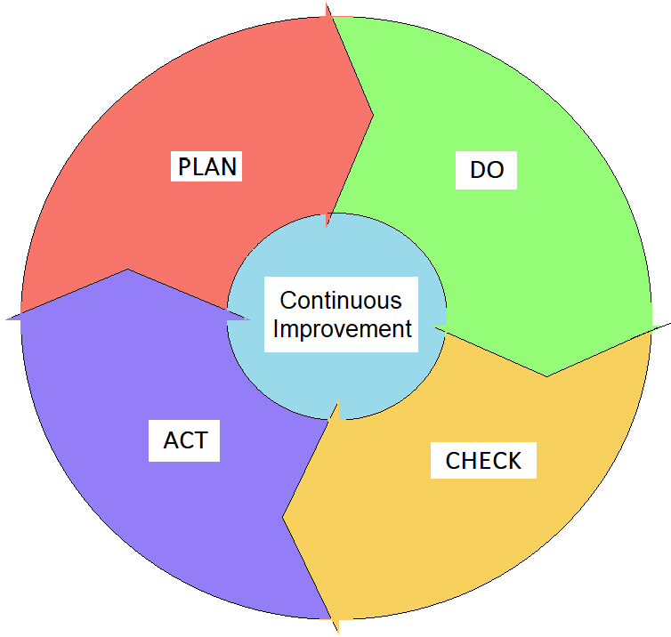
Continuous Improvement Plan: PDCA

Slide 11
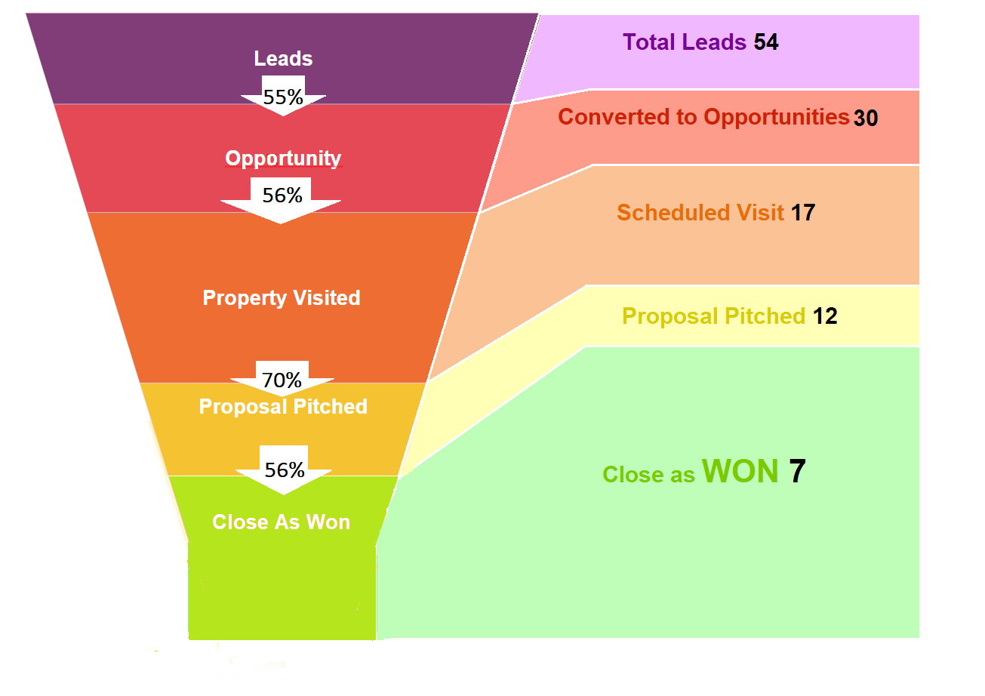
Opportunity Pipeline Management

Slide 12
Quick Fact!
2
Hamleys survived the great depression and German bombs.

Slide 13
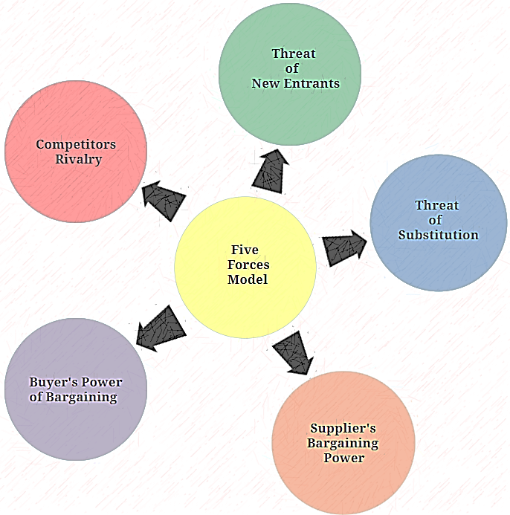
Porter’s Five Force Model

Slide 14
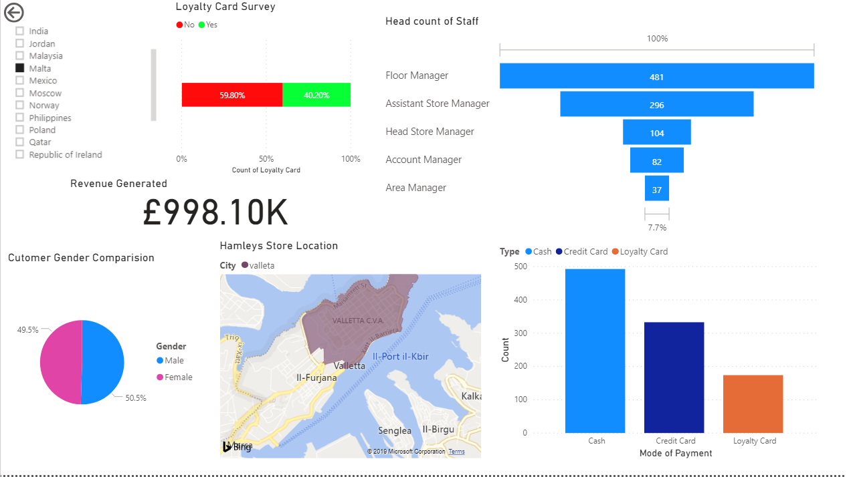
Dashboards

Slide 15
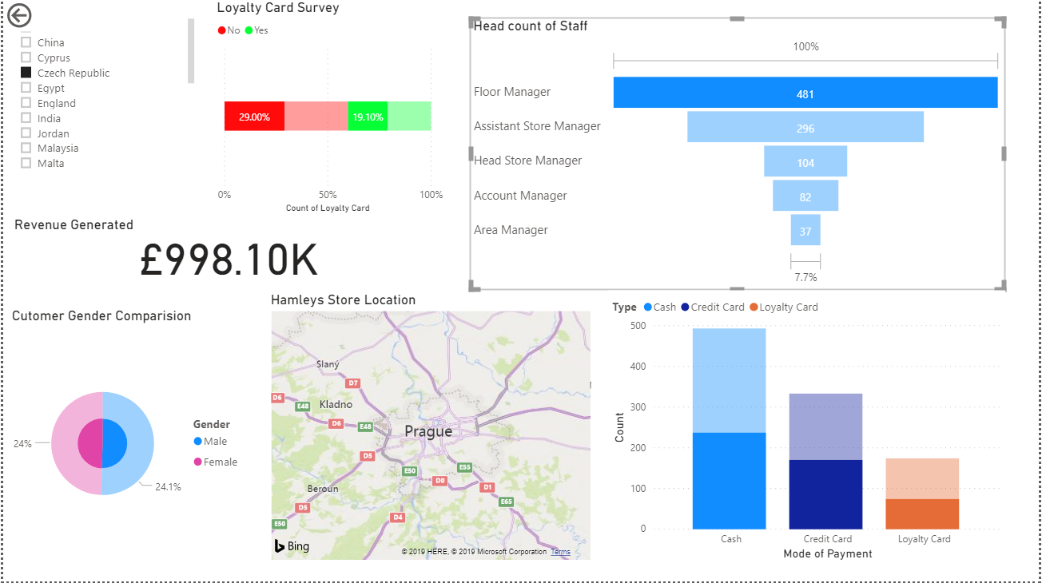
Dashboards

Slide 16
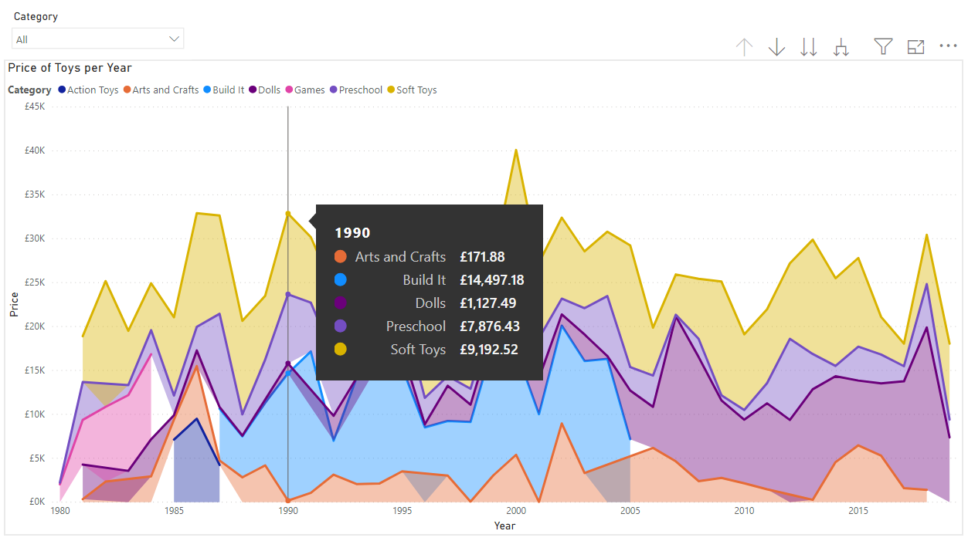
Sales Descriptive

Slide 17
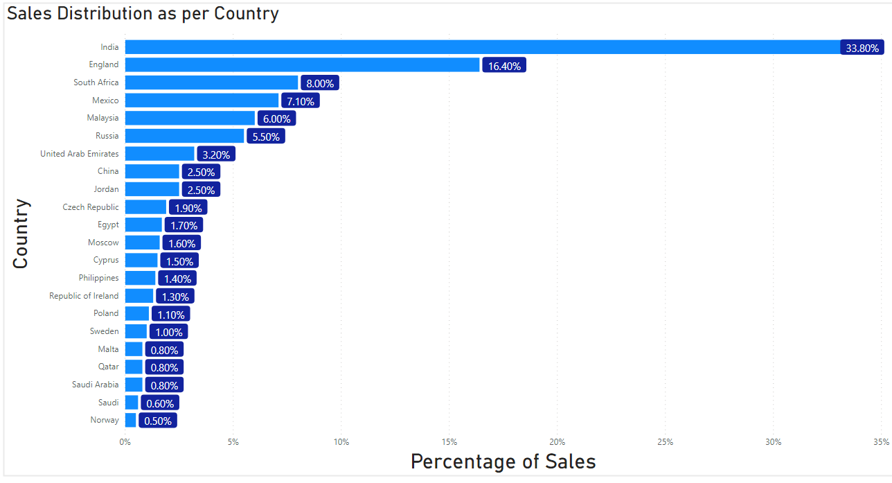
Sales Distribution as Country

Slide 18
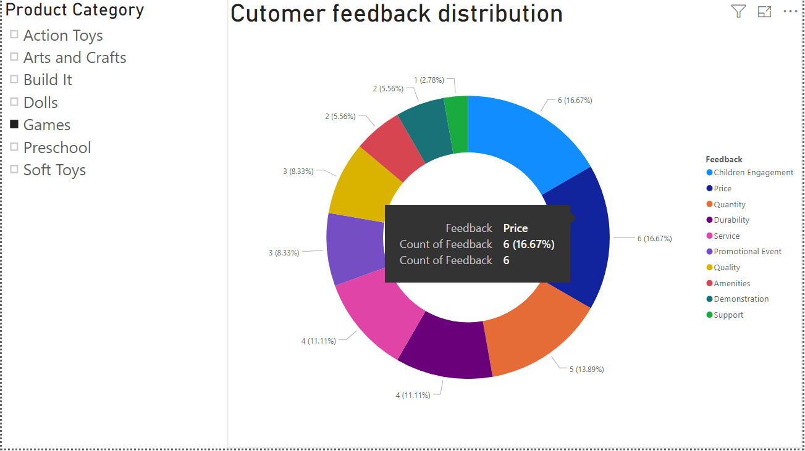
Customer Feedback Distribution

Slide 19
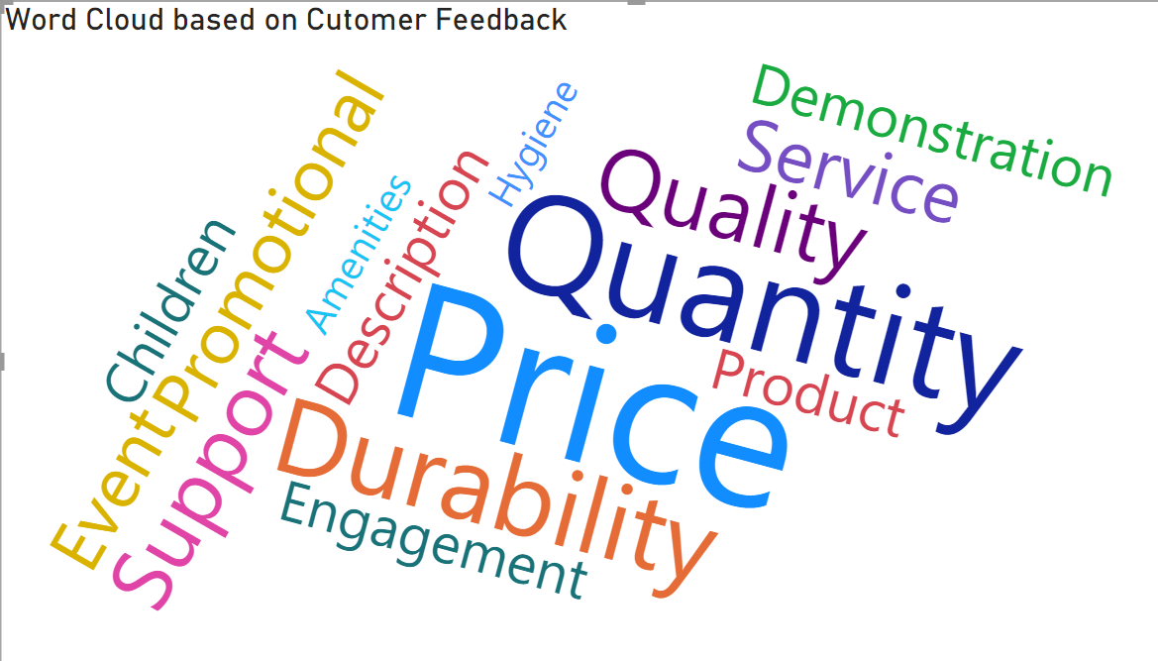
Text Analysis of Customer Feedback

Slide 20

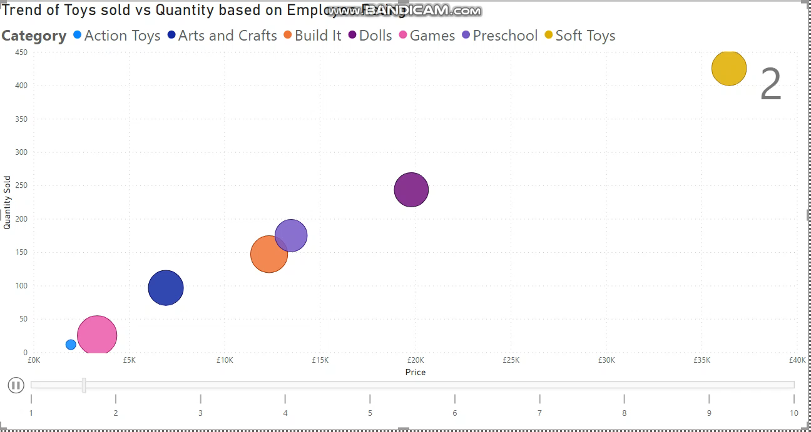
Trends of Toys Sold Vs Quality of Employee

Slide 21
Quick Fact!
3
Hamleys constructed ‘Lego’ bus stop at Regent street, London in 2014 which was operational for a month.

Slide 22
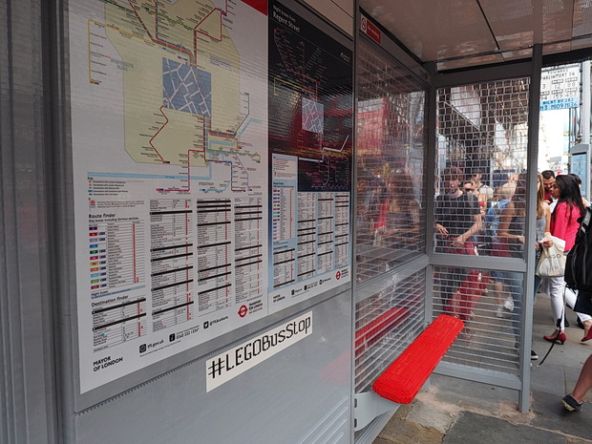
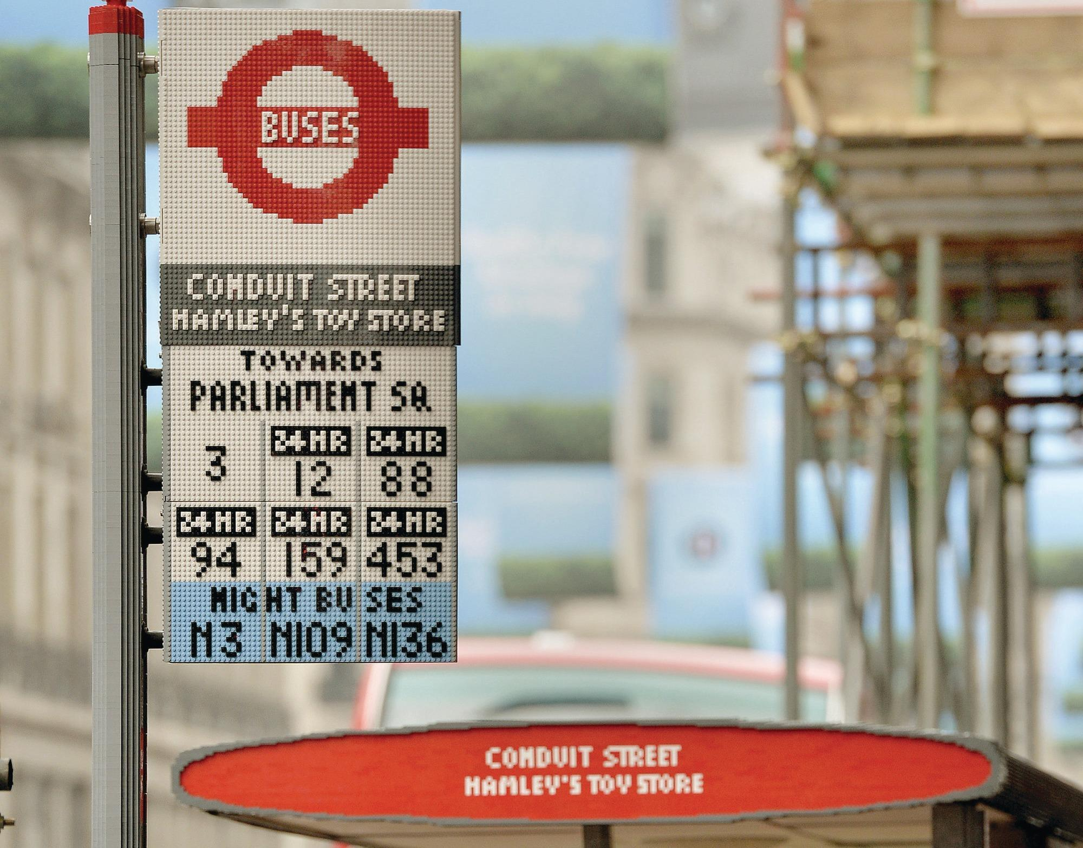
Source: https://www.google.ie/imghp
Probably wouldn’t sit on the Lego bench though!

Slide 23
Microsoft Dynamics
Feedback: Customer feedback routed as a case among teams
Supplier response: Custom field for suppliers to agree/disagree over a customer suggestion/request. Status mails to the suppliers and customers

Slide 24
Leads and acquisitions: Promising retail shop owners recorded in the system based on customer responses and further qualified as opportunities on the basis mail replies
Loyalty Cards: Customers with no loyalty card contacted and made aware of the perks

Slide 25
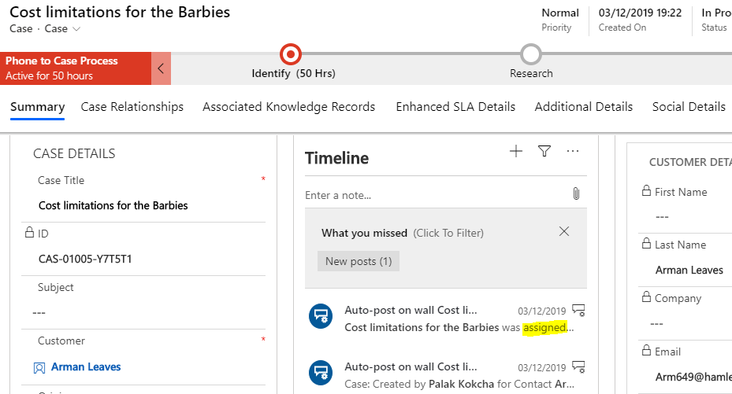

Slide 26
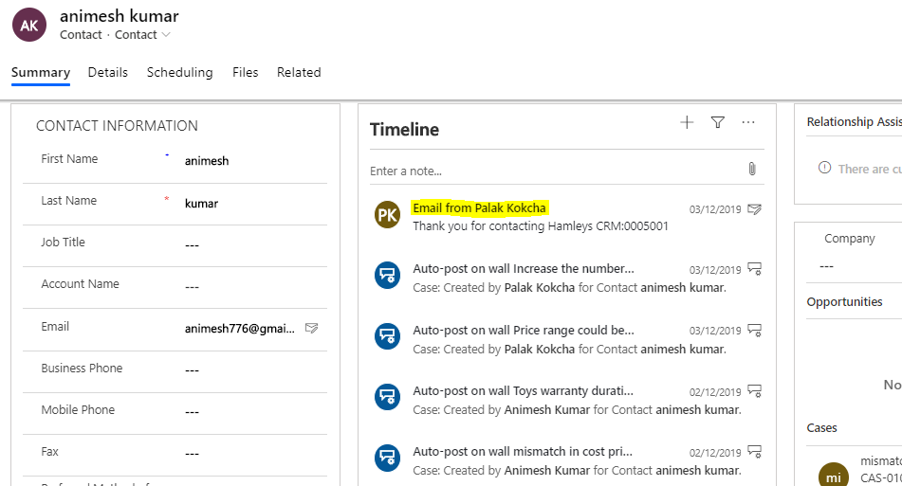

Slide 27
References
“BBC - The history of Hamleys - London’s famous toy shop.” [Online]. Available: http://news.bbc.co.uk/local/london/hi/people_and_places/history/newsid_8510000/8510277.stm. [Accessed: 07-Dec-2019].
https://www.slidescarnival.com/hume-free-presentation-template/9195#preview

Slide 28
Thanks!
Any questions?

